Slide 1


Крачещо роботче
От Биляна Борисова и Валентин Димитров
Научен ръководител инженер Венцислав Начев
Доц. Иван Чавдаров от Българската Академия на Науките

Slide 2
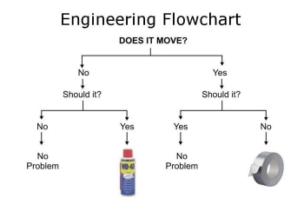
Цели, идеи и реализация

Slide 3
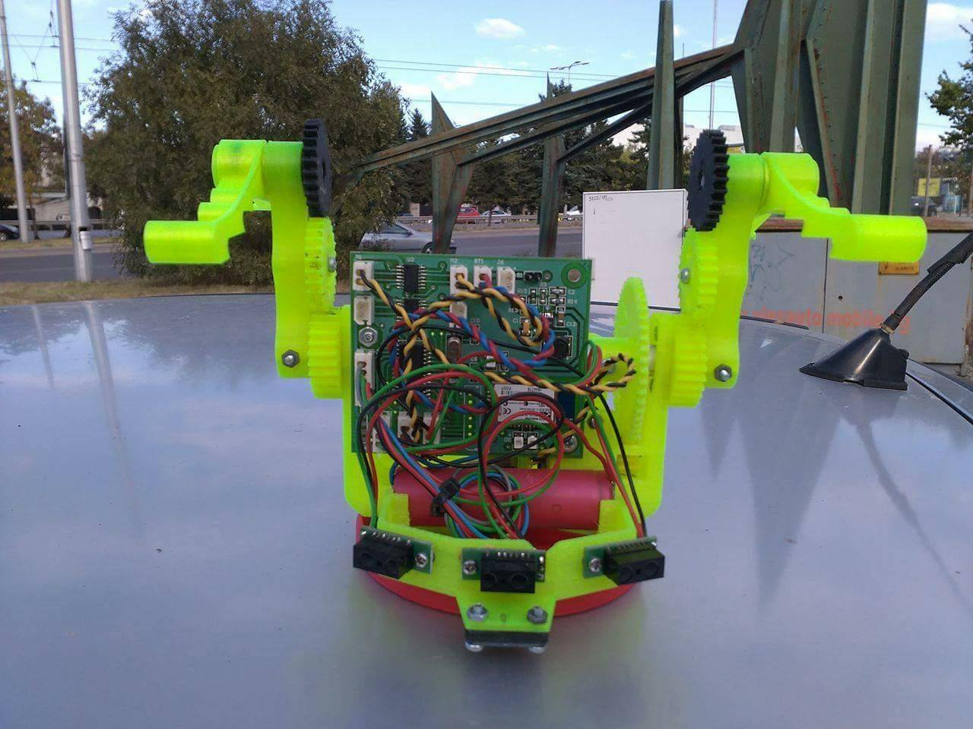
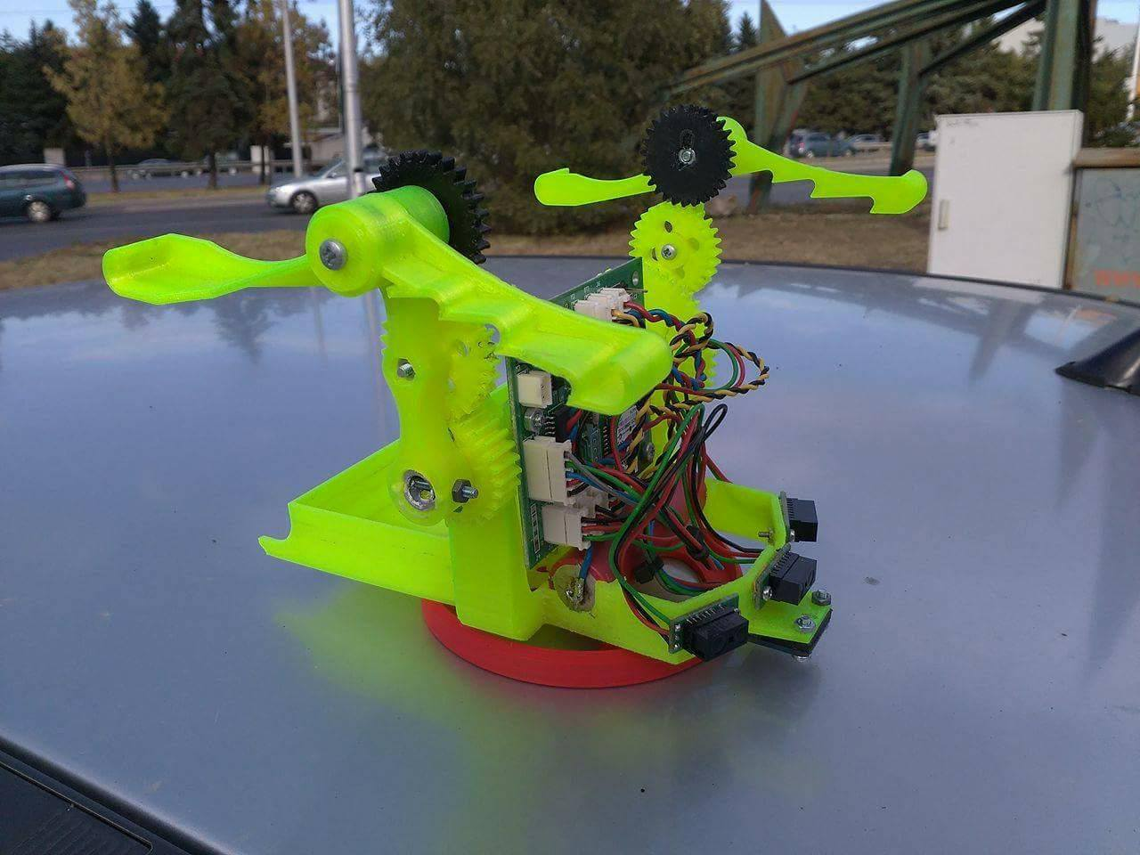

Slide 4
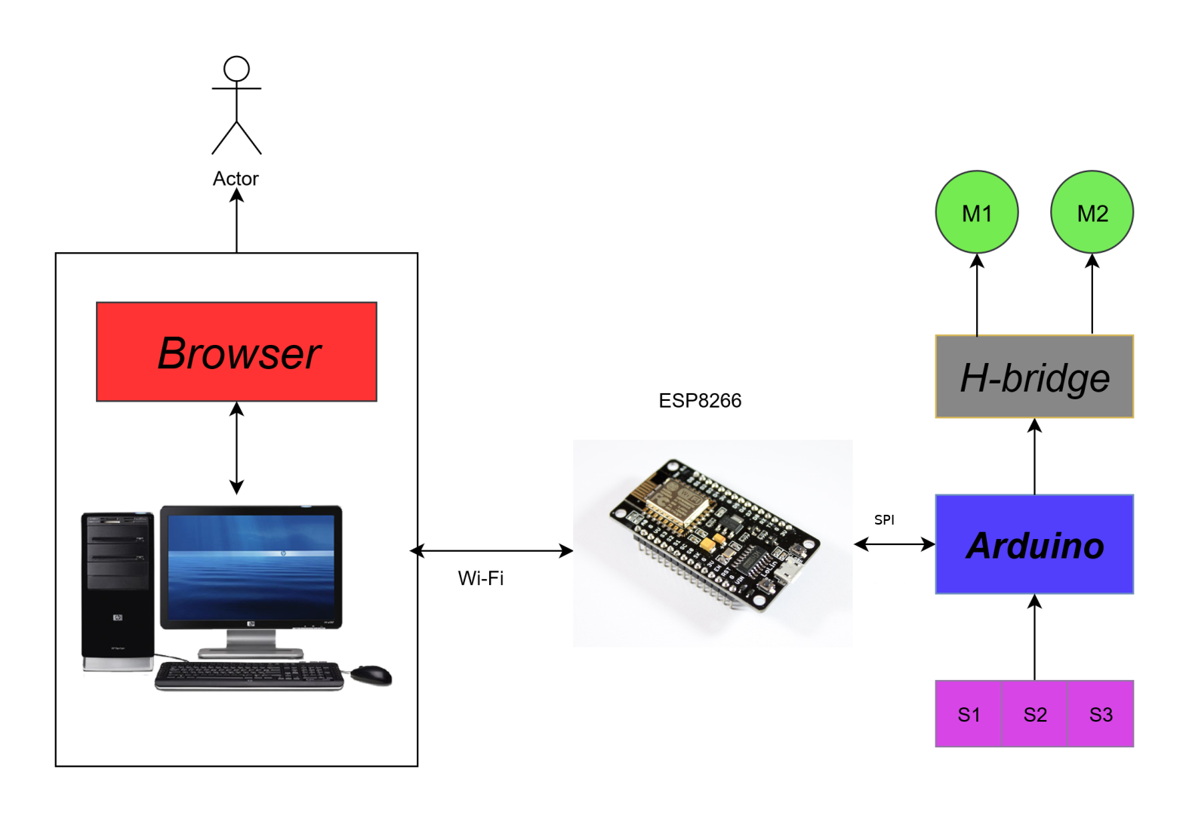

Slide 5
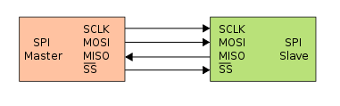
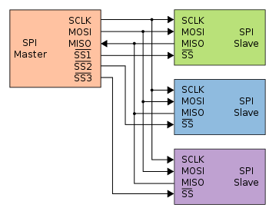
MISO (Master In Slave Out)
Master receives data and slave transmits data through this pin.
MOSI (Master Out Slave In)
Master transmits data and slave receives data through this pin.
SCLK (Serial Clock)
Master generates this clock for the communication, which is used by slave.
Only master can initiate serial clock.
CS (Chip Select)
Master can select slave device through this pin to start communication with it.

Slide 6
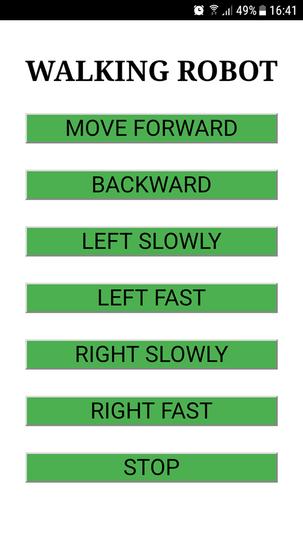

Slide 7
ДЕМОНСТРАЦИЯ

Slide 8
ВЪПРОСИИИИИИ

Slide 9

Благодарим за вниманието

